Slide 1

TCF Factorlink Credit Risk Model
Sep 2020

Slide 2
Agenda –
What is Credit Risk
Financial crisis in 2008
How Expected Loss is calculated
Standard Approach
Internal Rating based approach
A robust machine learning approach for credit risk analysis
Demo
Q & A
What's Next

Slide 3

Credit Risk
Credit risk is the likelihood that a borrower would not repay their loan to lender
Risk is that of the lender and includes lost principal and interest, disruption to cash flows, and increased collection costs.
There are 3 type of credit risk
Credit spread risk occurring due to volatility in the difference between investments' interest rates and the risk-free return rate.
Default risk arising when the borrower is not able to make contractual payments.
Downgrade risk resulting from the downgrades in the risk rating of an issuer.

Slide 4
Financial crisis in 2008
The financial crisis of 2007–2008, also known as the global financial crisis (GFC), was a severe worldwide financial crisis.
The crisis sparked the Great Recession, which, at the time, was the most severe global recession since the Great Depression.
The stock market crashed in 2008 because too many had people had taken on loans they couldn't afford.
Lenders relaxed their strict lending standards to extend credit to people who were less than qualified. This drove up housing prices to levels that many could not otherwise afford.
The 2008 crash only took 18 months.
Among the things that caused the financial crisis was that the Basel II committee and banks underestimated both the risk of losses on their assets and their exposure to the failure of others.

Slide 5
How Expected Loss is calculated
The expected loss is calculated as a loan’s LGD multiplied by both its probability of default(PD) and the financial institution’s exposure at default(EAD).
EL(expected loss) = PD(probability of default) * LGD (loss given default) * EAD (exposure at default)
UL (unexpected loss) = result of economic depression
PD: probability of borrower inability of repayment
LGD : proportion of total exposure that cannot be recovered by lender once a default occurred
EAD : total value that a lender is exposed to when a borrower defaults

Slide 6
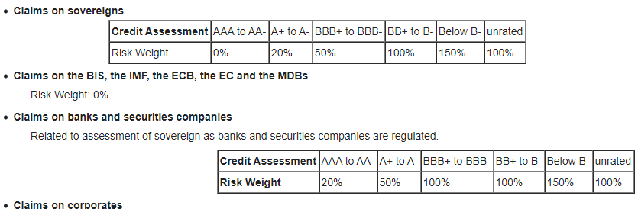
Standard Approach
The term standardized approach refers to a set of credit risk measurement techniques proposed under Basel II capital adequacy rules for banking institutions.
Under this approach the banks are required to use ratings from External Credit Rating Agencies to quantify required capital for credit risk. In many countries this is the only approach the regulators are planning to approve in the initial phase of Basel II Implementation.
The Basel Accord proposes to permit banks a choice between two broad methodologies for calculating their capital requirements for credit risk. The other alternative is based on internal ratings.

Slide 7
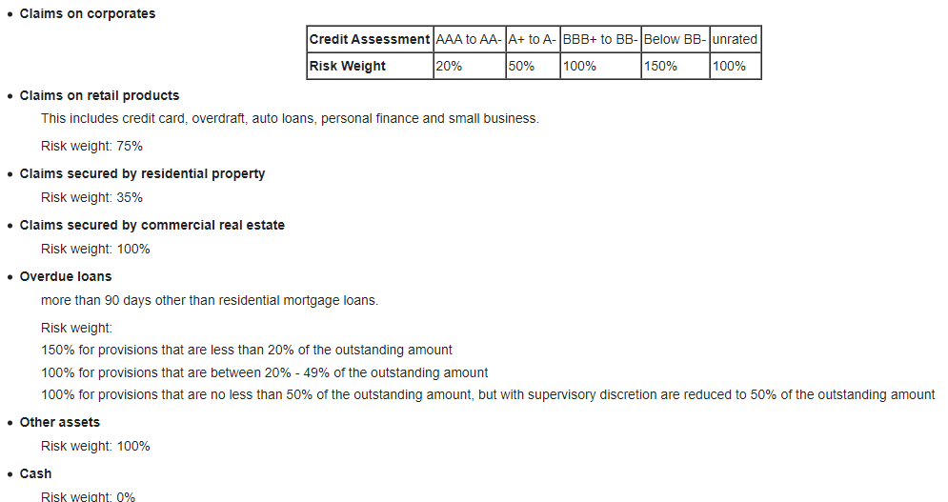
Standard Approach

Slide 8
Internal Rating based approach
The term Foundation IRB or F-IRB is an abbreviation of foundation internal ratings-based approach, and it refers to a set of credit risk measurement techniques proposed under Basel II capital adequacy rules for banking institutions.
Under this approach the banks are allowed to develop their own empirical model to estimate the PD (probability of default) for individual clients or groups of clients. Banks can use this approach only subject to approval from their local regulators.
Under F-IRB banks are required to use regulator's prescribed LGD (Loss Given Default) and other parameters required for calculating the RWA (Risk-Weighted Asset) for non-retail portfolios.
For retail exposures banks are required to use their own estimates of the IRB parameters (PD, LGD, CCF). Then total required capital is calculated as a fixed percentage of the estimated RWA.

Slide 9
A robust machine learning approach for credit risk analysis
“Learn” without being explicitly programmed
Unveiling new determinants and unexpected forms of dependencies among variables.
Tackling non-linear relationships. Credit Risk Analysis Machine and Deep learning techniques
Use of ML and Deep Learning are favored by the technological advances and the availability of financial sector data.
Supervisory authorities should keep up with the current developments.

Slide 10
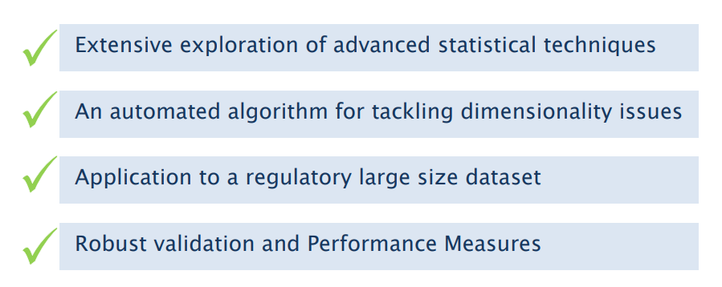
A robust machine learning approach for credit risk analysis

Slide 11
Demo

Slide 12
Next Steps

Slide 13

Thank you

